Slide 1
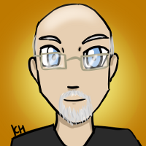
Welcome!
Please log in...
I’m Mr Beens (Google “Mr Beens’ Class”)

Slide 2
Areas within BDSS Technology
Auto
Communications Technology
Computer Technology
Computer Science
Construction
Electricity
Hairstyling & Aesthetics
Horticulture
Hospitality (Foods)
Welding

Slide 3
Subjects taught by Mr Beens
Communications Technology TGJ (10-12)
Photoshop, Photography, Graphic Arts, Videography
Computer Science ICS (11-12)
Coding!
Computer Technology TEJ (10-12)
Computer Hardware, Computer Networking, Computer Repair, Electronics, Computer Interfacing

Slide 4
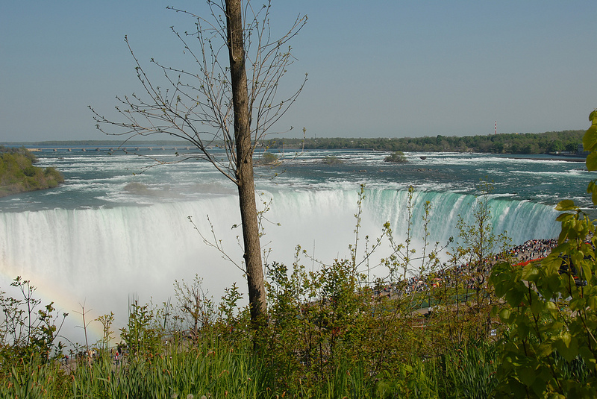
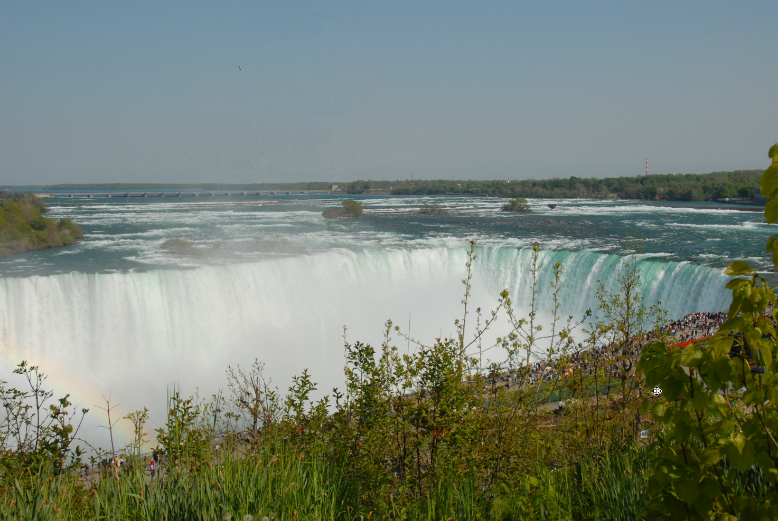
Comm Tech (TGJ) - Photoshop - Remove Tree
(before and after)

Slide 5
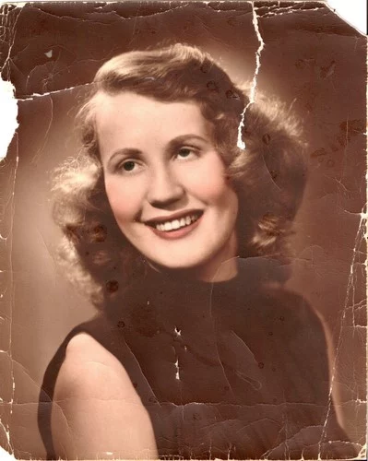
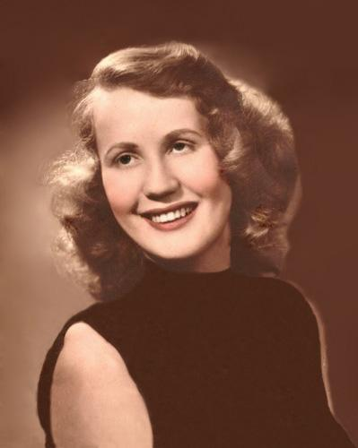
See also http://blog.beens.org/2015/09/photo-repair-which-do-you-like-best.html
Comm Tech (TGJ) - Photoshop - Repair Portrait
(before and after)

Slide 6
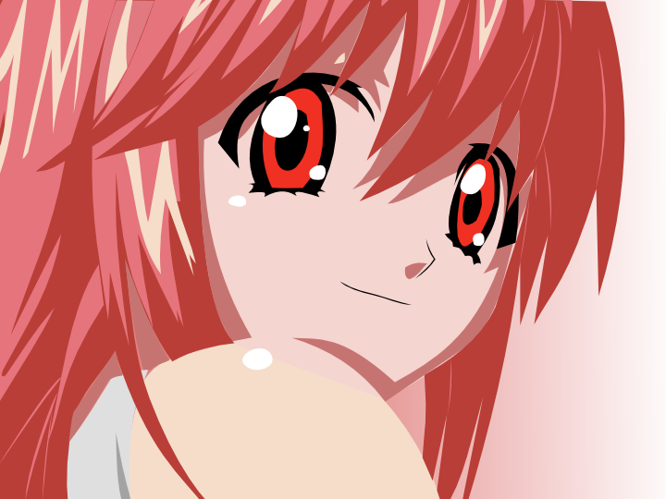
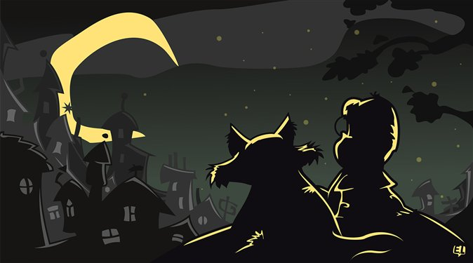



Comm Tech (TGJ) - Graphic Arts - Media Trace

Slide 7
Our First Arduino Program!

Slide 8
“Blink”
This program turns on an LED on for one second, then off for one second, repeatedly.
Most Arduinos have an on-board LED you can control. On the Uno and Leonardo, it is attached to digital pin 13.
Credit(s): http://labs.arduino.org/STARTER+KIT+-+GET+TO+KNOW+YOUR+TOOLS

Slide 9
“Blink” (step 1)
void setup() {
}
void loop() {
}
Credit(s): http://labs.arduino.org/STARTER+KIT+-+GET+TO+KNOW+YOUR+TOOLS

Slide 10
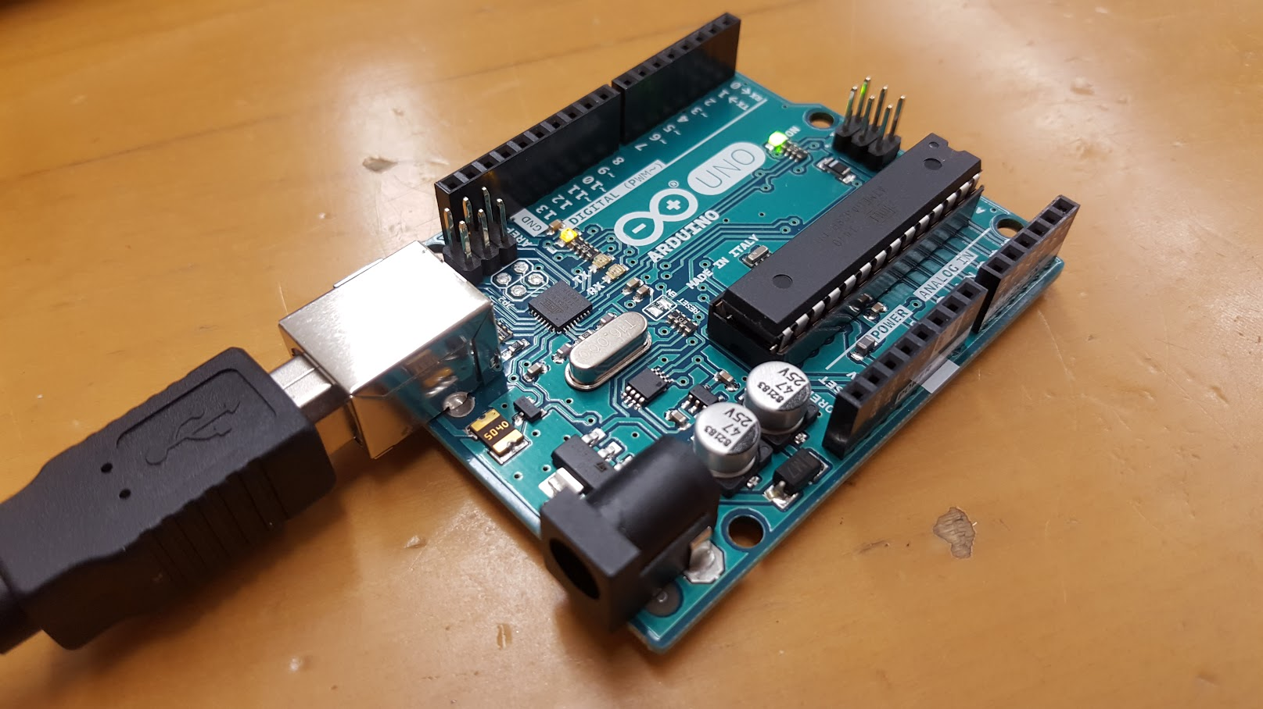
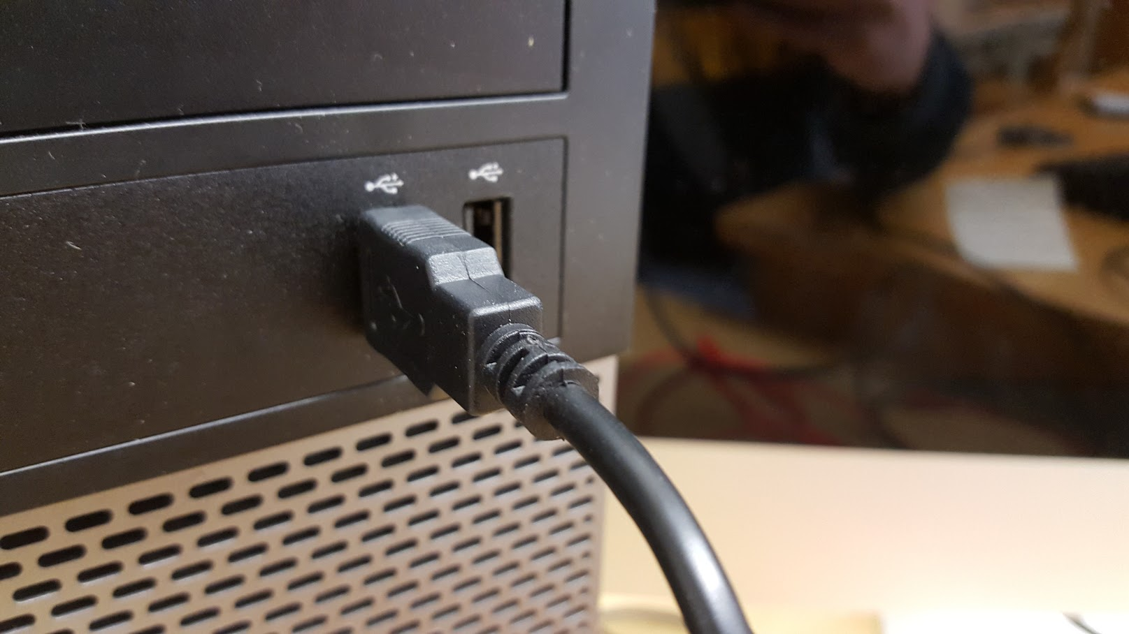
Connect Your Arduino...

Slide 11
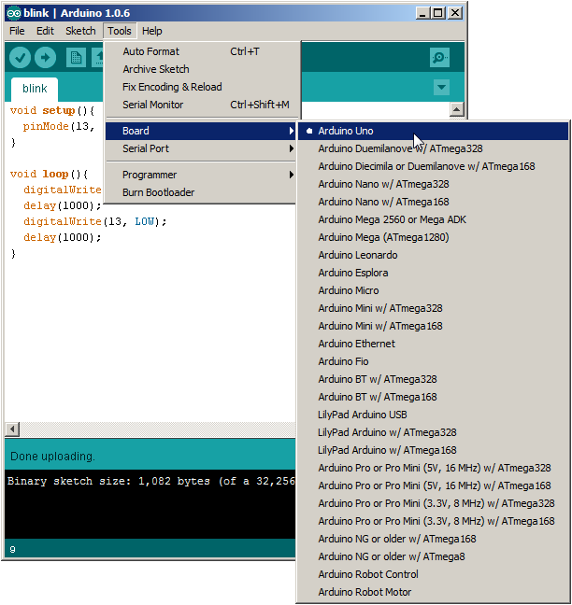
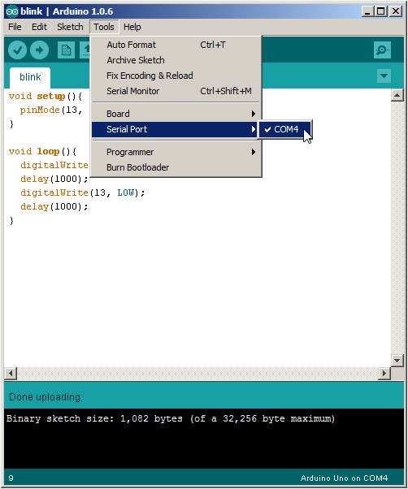
Before Uploading...

Slide 12
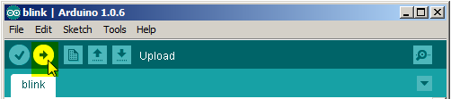
Upload!

Slide 13
“Blink” (step 2)
void setup() {
pinMode(13, OUTPUT);
}
void loop() {
digitalWrite(13, HIGH);
}
Credit(s): http://labs.arduino.org/STARTER+KIT+-+GET+TO+KNOW+YOUR+TOOLS

Slide 14
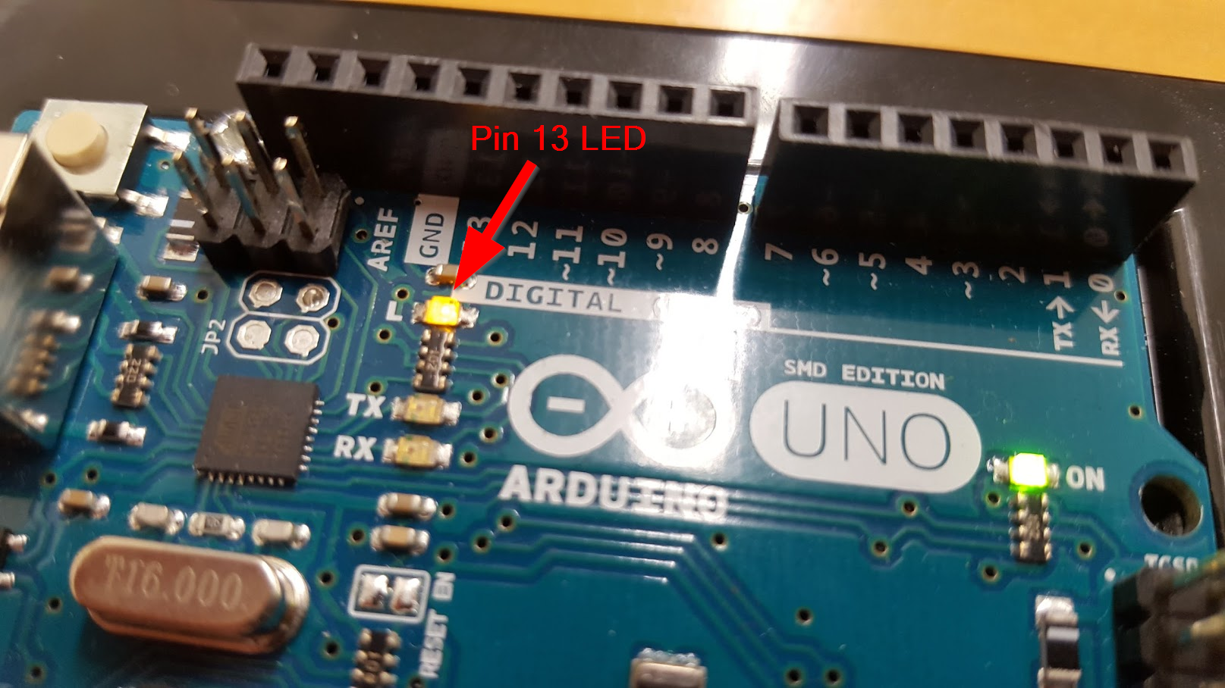
Did it Work?!!

Slide 15
“Blink” (step 3)
void setup() {
pinMode(13, OUTPUT);
}
void loop() {
digitalWrite(13, HIGH);
delay(1000);
digitalWrite(13, LOW);
delay(1000);
}
Credit(s): http://labs.arduino.org/STARTER+KIT+-+GET+TO+KNOW+YOUR+TOOLS

Slide 16
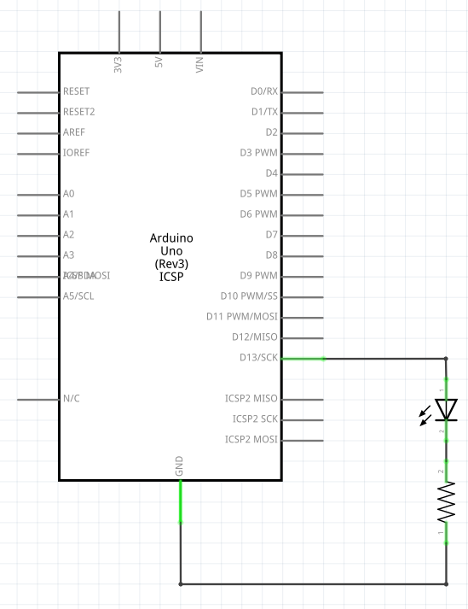

Slide 17
